Slide 1
Training Module on Interpersonal Skills & Team Building
Session 1. IP Skills
By ACA BEHAVIOR SCHOOL
Prof. SHANKAR BHUSARI
(BSc, M.A.(Psychology), MBA (HR & Finance)

Slide 2
Interpersonal Communication
Very few communications are between a person and mass of people. Communications at large are between two people – it is interpersonal communication such as dialogue, conversation, interview, chat or gossip.

Slide 3
What are Interpersonal Communication
Dialogue – It is exchange of thoughts, ideas, emotions and actions between two persons, most spoken and sometimes written.
Conversation – An oral or informal exchange of sentiments, observations and opinions between two persons.
Interview – A face to face meeting, formal or official between two or more people for the purpose of obtaining information or sharing expertise.
Chat – Talks between two people or groups, in an informal manner to share views, ideas and creativity.
Gossip – Talks about personal or private affairs. It is habit of a person to reveal personal, sensational facts about others.

Slide 4
IP Skills – Social & Organization Context
In the social context, Interpersonal skills are abilities of a person to interpret and manage own & others feelings, actions and motivations.
In the organizational context, interpersonal skills refer to a employee’s ability to interact effectively with other members of the organization.

Slide 5
Skills and trait of Interpersonal Skills
It includes,
Communication and listening skills,
Positive attitude and deportment (mannerism),
Conflict handling and using feedback.

Slide 6
Why IP skills are required?
Reasons – (KARAN)
The skills used by a person to properly interact with others.
It is employee’s ability to get along with others while getting the job done.
It refers to character traits possessed by an individual rather than skills that can be taught in a classroom.
Effect – (PRABHAV)
Good interpersonal skills are a prerequisite for many positions in an organization, including yours.
Outcome – (PARINAM)
Employees with good interpersonal skills are likely being more productive than those with poor interpersonal skills, because of their tendency to project a positive attitude and look for solutions to problems.

Slide 7
Do you have it ? Or Don't.
If, you have it -
It allows you to develop your ability to gather all the information in your interpersonal experiences.
It permits you to think and write the information you gathered during an interpersonal experience which will help you understand what you missed.
Information critical to effectively communicating our thoughts and ideas are available in all of our experiences. And, if you don’t use it, then you miss IpS.
Are you using everything available with you, positively to mutual benefit?
Do you agree on your own disagreements with you?
Do you agree on others disagreements with you?
If No! (Watch this Video)
Do the exercise again and again with your recent or past experiences.

Slide 8
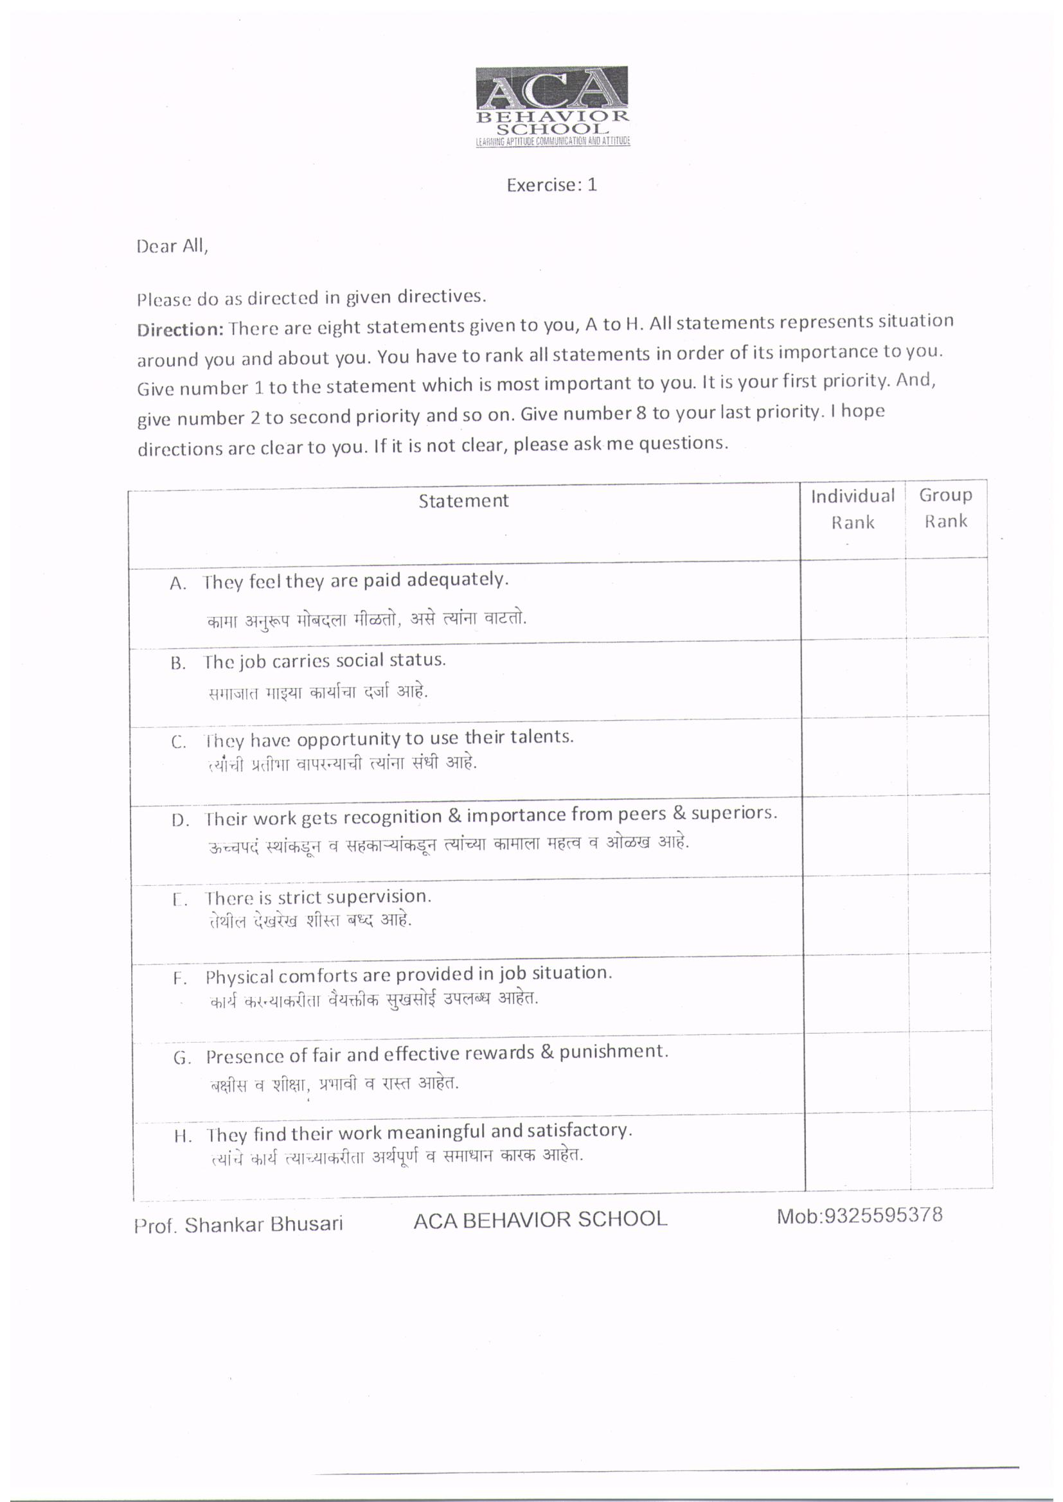

Slide 9
Developing Interpersonal Skills
What to develop?
Assertiveness – An individual place himself in physical, verbal and social equality with others and state his point of view clearly without being aggressive. But, if intent to hurt others, then losses assertion and leads to aggression.
Empathize – The person is not too emotional and not emotionless. In other word, do not sympathize; do not have apathy (lack of concern).
Initiative – Readiness to engage and get into tough jobs or activities.
Accept responsibility – Mental state of mind to take responsibilities of the job and readiness to deliver performance.
Avoid Conflict – It is physical and psychological. Physical avoidance is to avoid taking phone calls and talks with people involved in conflicts. Psychological avoidance involves refusing to acknowledge the existence of the problem or its seriousness. This tactics is successful only in short term.
Accommodate & compromise for oneness – Accommodating involves sacrificing one’s position and paying more importance to reaching an agreement. Compromise involves, both parties forgo something which they were trying to achieve for oneness (to show unity)
Mannerism – This is adherence to particular style or manners suitable to your job, in terms of gesture and posture.

Slide 10
How to Develop?
Have attitude like Rahul Bajaj.
(Watch Video)
Handle conflicts like Sunita Narayan.
(Watch Video)
Be satisfied (Accommodate and Compromise) like Megha Patkar
(Watch Video)
Improve your communication & listening.
(Go to next slide)

Slide 11
What is effective Communication? Quality of communication: Effective use of quoted and reported speech. Effective use of punctuations (If you are writing). Effective use of pronunciation (Accent like ANNA HAJARE), Attitude (Tone like BARACK OBAMA) and Influence (Voice like MOTHER TERRESA) Behavioral Styles in Effective Communication: 1. Aggression or Assertion – Choice is yours. 2. Submissive or Supportive - 3. Managing to agree with disagreement. Listening: 1. Empathize with other. 2. Ask questions 3. Smile occasionally. 4. Discuss core issues. 5. Read to ideas not person. 6. Avoid jumping on conclusions. 7. Evaluates facts and evidence. Improving Communication: 1. Selling to yourself – your ideas, dreams and visualizations. 2. Presentation Skills – Image, expressions and rapport.

Slide 12
Session 2-Team Building
Team building is a process that develops cooperation and teamwork within a work unit.
Team must share a common goal, have respect for each other, and be motivated to use the strengths of each member to achieve their objectives.
Each member of a team plays an integral part in the success of the company.
The team nurture communication within the organization to avoid extreme stress on individual.
An individual can be members of several teams which provide him/her a sense of loyalty and ownership.

Slide 13
Team Building Activities
Workshops & Seminars (Sharing)
Brainstorming (Idea generation)
Collaboration (Reduce stress)
Creativity (Offer opportunity)
Problem solving (Activation)
Conflict resolution (Oneness)
Participation (Involvement)
Celebrations (Recognition)

Slide 14
On-site team building activities – Activities planned and executed in the premises of the organization. Off-site team building activities – Important activities planned and executed away from the place of the organization. When planning or choosing a team building event, try to plan the event at an off-site location. Be prepared for the session by bringing items you will need. Be flexible and have a back-up plan in case you encounter hurdles. Use appropriate safety measures as needed. Remember to involve all parties and anticipate opposition and blunders. Because individuals learn differently, incorporate components for those who learn through sight, sound, and touch. Encourage participants to go with the flow, even when the plan deviates. Allow time for thought and reflection, but end the event promptly.

Slide 15
Twelve Cs for Team Building
Successful team building, that creates effective, focused work teams, requires attention to each of the following.
Clear Expectations – Inform, share and act on expected outcome.
Context – Do you understand your importance in line with goal of organization?
Commitment – Are you dedicated to your job?
Competence – Do you have optimum resource to deal with your task?
Charter – Do you have your own mission for your own job?
Control – Do you have freedom and empowered to act in your area of work?
Collaborations – Do you and your team members have Interpersonal skills?
Communication – Are you clear about priorities?
Creativity Innovation – Does the organization (Management) really want to change?
Consequences – Do team members feel responsible and accountable for outcome?
Coordination – Does the leader direct you positively to achieve goals?
Cultural Change – Does the leader ready to change and able to take reasonable risk?

Slide 16
THANK YOU Please do the given exercise at home WELCOME TO ACA BEHAVIOR SCHOOL FOR FURTHER LEARNING

